Slide 1

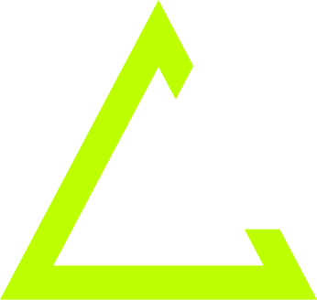


MINOR PROJECT
TENNIS GAME
BY: ANKIT TIRKEY
ROLL NO: 20222714
GITHUB LINK: GITHUB REPOSITORY

Slide 2
INTRODUCTION
"A Unity-based tennis simulation with a player-controlled character and AI-driven bot, featuring realistic physics and animations."
Key elements:
Player and AI interactions.
Real-time ball physics.
Seamless animations.

Slide 3
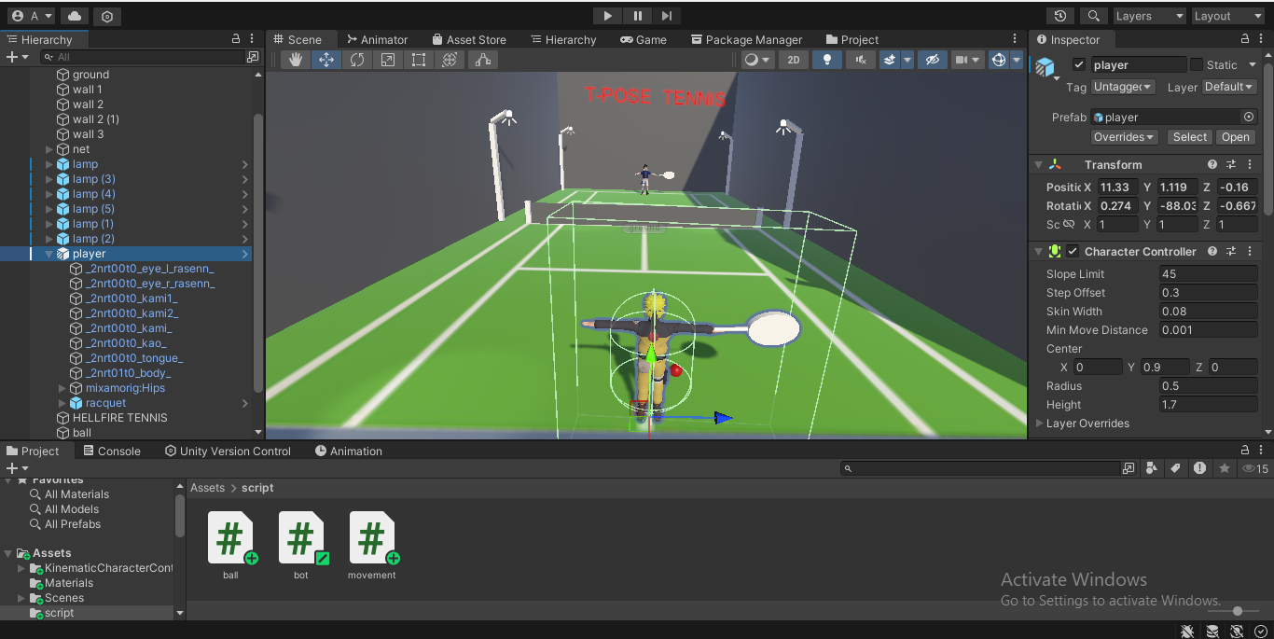
OBJECTIVE OF THE GAME
Primary Goal:
Keep the ball in play by hitting it back and forth with precision and timing.
Features:
Realistic player movement.
AI bot as a challenging opponent.
Physics-based ball interactions.

Slide 4
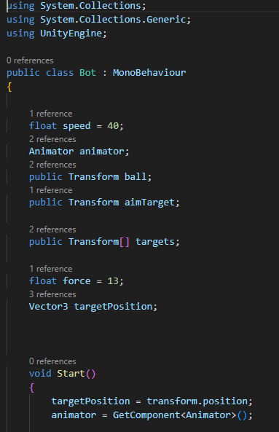
TECHNOLOGY AND SCRIPTS
Technologies Used:
Unity Physics: Realistic interactions.
Animator: Smooth animations.
Input System: Player controls.
Key Scripts:
Movement Script: Player control and hitting mechanics.
Bot Script: AI movement and aiming logic.
Ball Script: Ball position reset for seamless gameplay.

Slide 5
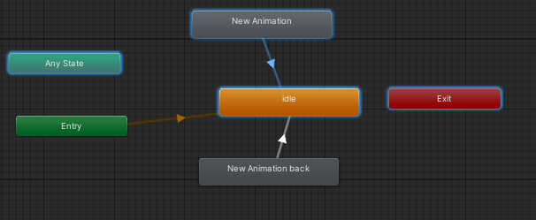
SYSTEM ARCHITECTURE
Integration:
Ball behavior: Resets on collision.
Bot behavior: Tracks and hits the ball.
Player movement: Dynamic control and aiming.
Data Flow Diagram (DFD):
Player Inputs → Movement Script → Animator → Actions.

Slide 6
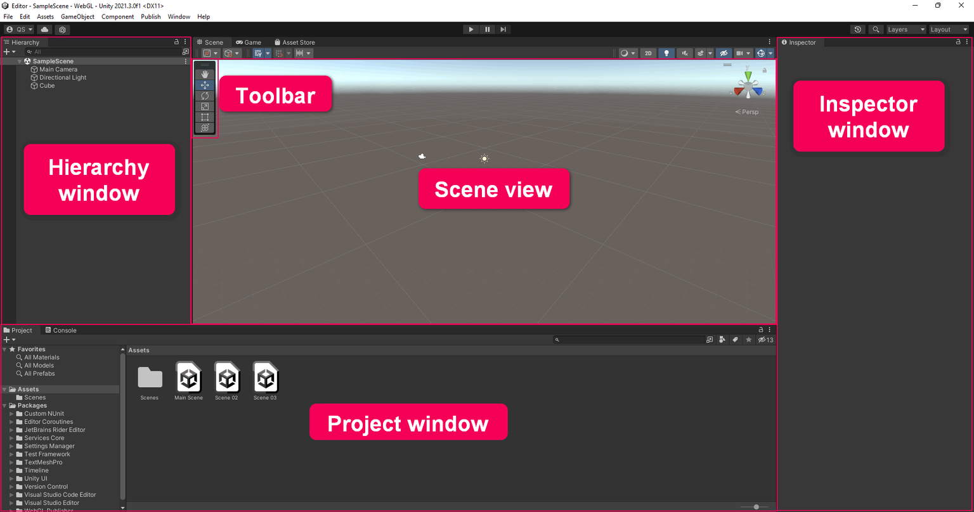
HOW TO RUN THE GAME
Open Unity Hub: Load the project.
Verify Objects: Ensure Player, Bot, Ball, etc., are present.
Configure Scripts: Assign values in the Unity Inspector.
Press Play: Start playing!
Option for pre-built game: GAME

Slide 7
CONCLUSION AND FUTURE SCOPE
Conclusion:
"This Unity-based project demonstrates interactive gameplay, realistic AI, and smooth animations. It serves as a solid foundation for further development."
Future Scope:
Improved AI for diverse behaviors.
Multiplayer functionality.
Additional levels and customization.

